Slide 1

CS489/698: Intro to ML
Lecture 08: Kernels

Slide 2
Outline
Feature map
Kernels
The Kernel Trick
Advanced

Slide 3
XOR revisited

Slide 4
Quadratic classifier
Weights
(to be learned)

Slide 5
The power of lifting
R^{d} → R^{d*d+d+1}
Feature map

Slide 6
Example

Slide 7
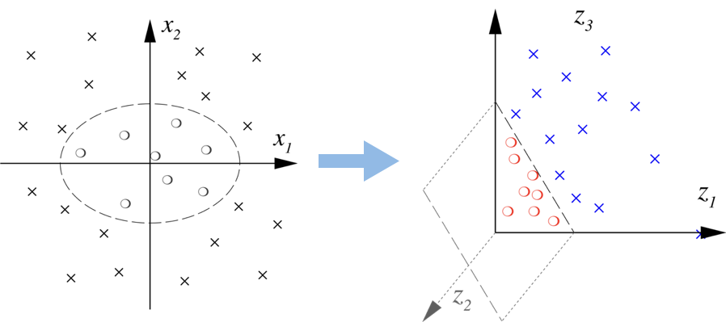
Does it work?

Slide 8
Curse of dimensionality?
computation in this space now
But, all we need is the dot product !!!
This is still computable in O(d)!

Slide 9
Feature transform
NN: learn ϕ simultaneously with w
Here: choose a nonlinear ϕ so that for some f : R→R
save computation

Slide 10
Outline
Feature map
Kernels
The Kernel Trick
Advanced

Slide 11
Reverse engineering
Start with some function , s.t. exists feature transform ϕ with
As long as k is efficiently computable, don’t care the dim of ϕ (could be infinite!)
Such k is called a (reproducing) kernel.

Slide 12
Examples
Polynomial kernel
Gaussian Kernel
Laplace Kernel
Matérn Kernel

Slide 13
Verifying a kernel
For any n, for any x₁, x₂, …, x_{n}, the kernel matrix K with
is symmetric and positive semidefinite ( )
Symmetric: K_{ij} = K_{ji}
Positive semidefinite (PSD): for all

Slide 14
Kernel calculus
If k is a kernel, so is λk for any λ ≥ 0
If k₁ and k₂ are kernels, so is k₁+k₂
If k₁ and k₂ are kernels, so is k₁k₂

Slide 15
Outline
Feature map
Kernels
The Kernel Trick
Advanced

Slide 16
Kernel SVM (dual)
With α,
but ϕ is implicit…

Slide 17
Does it work?

Slide 18
Testing
Given test sample x’, how to perform testing?
No explicit access to ϕ, again!
dual variables
kernel
training set

Slide 19
Tradeoff
Previously: training O(nd), test O(d)
Kernel: training O(n²), test O(n)
Nice to avoid explicit dependence on h (could be inf)
But if n is also large… (maybe later)

Slide 20
Learning the kernel (Lanckriet et al.’04)
Nonnegative combination of t pre-selected kernels, with coefficients ζ simultaneously learned

Slide 21
Logistic regression revisited
kernelize
Representer Theorem (Wabha, Schölkopf, Herbrich, Smola, Dinuzzo, …).
The optimal w has the following form:

Slide 22
Kernel Logistic Regression (primal)
uncertain predictions get
bigger weight

Slide 23
Outline
Feature map
Kernels
The Kernel Trick
Advanced

Slide 24
Universal approximation (Micchelli, Xu, Zhang’06)
Universal kernel. For any compact set Z, for any continuous function f : Z → R, for any ε > 0, there exist x₁, x₂, …, x_{n} in Z and α₁,α₂,…,α_{n} in R such that
decision boundary
kernel methods
Example. The Gaussian kernel.

Slide 25
Kernel mean embedding (Smola, Song, Gretton, Schölkopf, …)
feature map of some kernel
Characteristic kernel: the above mapping is 1-1
Completely preserve the information in the distribution P
Lots of applications

Slide 26

Questions?

